Slide 1



SQL Project By – Bhushan Prabhakar Dhawas
LinkedIn – (link)
Social Media
Analysis

Slide 2


Table of Content
About Meta
Problem Statement
Schema
Data Overview
Approach
Key Metrics
User Classification
User Activity (Photos, Likes, Comments)
Engagement Rate
Recommendation
Conclusion

Slide 3


About Meta
Meta, formerly known as Facebook, is a technology company founded by Mark Zuckerberg in 2004. It rebranded to Meta in October 2021 to emphasize its focus on building the “Metaverse," a virtual reality space where users can interact in a shared, immersive environment. Meta's ecosystem includes social media platforms like Facebook, Instagram, and WhatsApp, as well as technologies for augmented and virtual reality, such as Oculus. The company's vision is to create a new digital frontier where people can connect, work, and play in virtual worlds that blend seamlessly with the physical world.

Slide 4
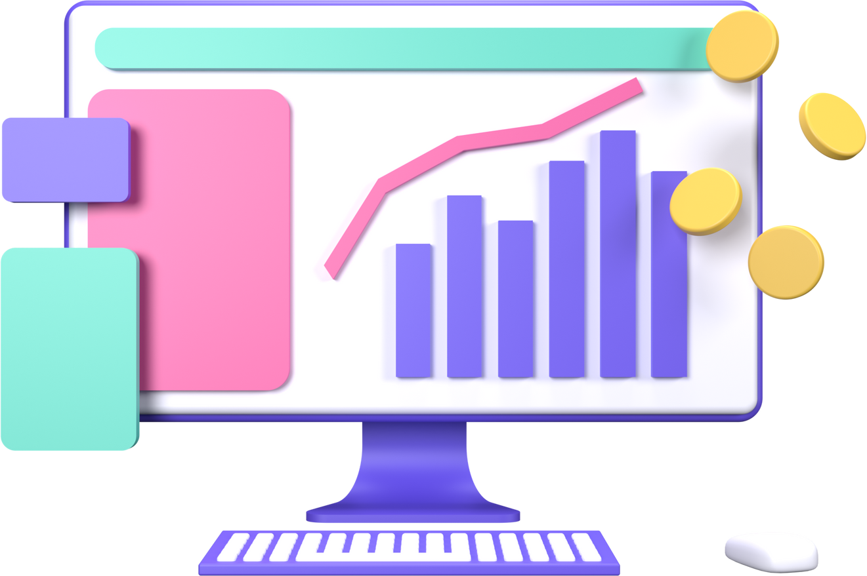

Problem Statement
You are hired as a data analyst at Meta and asked to collaborate with Marketing team. Marketing teams wants to leverage Instagram's user data to develop targeted marketing strategies that will increase user engagement, retention, and acquisition. Provide insights and recommendations to address the following objectives

Slide 5

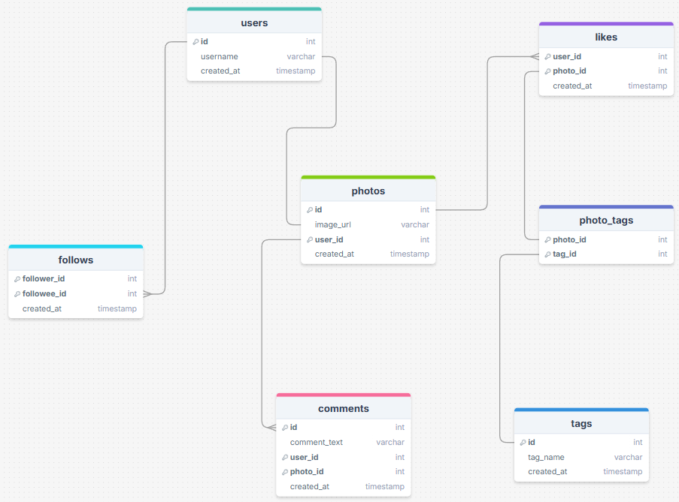

Schema

Slide 6



Data Overview
● comments_id : unique identifier for each comment
● comment_text : text content of a given comment
● user_id : unique identifier for each user
● photo_id : unique identifier for each photo
● created_at : date of interaction in the form like, photos, tags
● follower_id : user_id of the follower for a certain user
● followee_id : user_id of followee for a certain user
● tag_id : unique identifier for each tag
● image_url : link to the image posted on the platform
● username : username chosen by the user

Slide 7

Data Overview
Total 7 Tables are present in the given dataset.
Tables in dataset- users, comments, likes, photos, photo_tags, tags, follows.
Total number users are 100.
Total number of posts made so far is 257.
Total number of likes posted by the users on posts is 8782.
Total number of comments on all posts are 7488.

Slide 8


Approach
1.Understanding Problem Statement
4.Data Visualization
Identifying the key questions ,the goals of the analysis, and the data available to address them.
Visualized key metrics such as total posts, likes, and comments Created charts and graphs to rank users based on engagement rates and to highlight the most influential hashtags.
2.Data Cleaning and Validation
5.Stagegy Making
Checked and removed duplicates in the data sets also treated null values.
Prepared plans and strategies for increasing user retention and increasing engagement activities.
3.Analysis
6.Implementation
Utilized SQL functions like CTE ,Aggregate
Functions , Subqueries , Group by clause,
Rank functions and etc. for analysis.
Implementation of the plans and strategy are also discussed for optimised and better results.

Slide 9






Key Metrics
Likes
Comments
Photos
With the help of these metrics we can find the engagement rate of the users and categories them based on that. It help to implement strategies to solve problems.

Slide 10

User Classification
Out of 100 users there are only 30% of Active Users.
34 % of users are Moderate Active Users.
Inactive Users are the those users who have very low engagement rate and they are 34 %.
There are total 100 users.
There users who created their account before 2017 are considered as Old Users else New Users.
65% of users are Old Users and 35 % of users are New Users.

Slide 11
User Activity On Photos
The chart shows the data of Total number of Posts for Users.
Out of 100 users only 74 users post the photo.
The majority (18) of users have only 1 post .
Only 7 users are posting photos more than 5.
As the number of post increases ,the user count decreases significantly.
This indicates that most users are minimally active.
The Hashtags with the highest engagement rate are:
1.beauty 2.delicious 3.foodie 4.dreamy
5.food 6.photography 7.smile 8.stunning
9.sunset 10.beach

Slide 12
User Activity On Likes
The chart shows the Number of Likes for each User.
13 users have 257 likes which is the highest Number of Likes among all of the users.
Majority of users have less than 100 likes.
23 users have no like out of 100 users.

Slide 13

User Activity On Comments
The chart shows the Number of Comments for each User.
13 users have made 257 comments which is the highest number of comments made by an user.
Majority of users have less than 90 comments.
23 users have no comments out of 100 users.
These numbers can affect the engagement rate.

Slide 14
Engagement Rate
The Engagement Rate is calculated by the sum of Number of Likes and Number of Comments for each User.
The chart shows top 20 engaged users among total 100 users.
Meggie_Doyle has the highest average engagement rate i.e. 75 .
Majority of users have less than 70 average engagement rate.
There is need of making the user experience better in order to increase average engagement rate.

Slide 15



Recommendation
Re-Engaging user
Personalized Recommendation: | Use Instagram insights of user to analyze interests and interactions. Create content tailored to specific user groups (e.g., age, location, interests).
Re-engagement E-mails: | Send personalized emails showcasing trending content or posts from their connections that they’ve missed. Suggest content, groups, or hashtags they might be interested in based on their past behaviour.
Hashtag Targeting: | Research popular hashtags. Identify relevant hashtags for your brand and target audience. Incorporate hashtags into your content and ads.

Slide 16

Recommendation
Re-Engaging user
Giving Discounts and Gift Card : | This is one of the most popular yet effective ways to honour a valued user. Because they find these rewards exciting, this will encourage them to utilize the site more.
Collaboration with Influencer: | Look for users with high follower counts and strong engagement rates. Prioritize those whose content aligns with your brand values and target audience. Approach them with clear objectives for the campaign. Monitor influencer performance using Instagram Insights.
Contests For Users : | Introduce challenges or contests with rewards for the most engaging content or for hitting specific activity milestones.

Slide 17
Recommendation
User Retention
Campaigns : | Identifying inactive users with previous data. Create personalized content and offers to re-activate them. Utilize Instagram's features like Stories and Reels to re-engage users
Simplifying the Use: | Offer templates or prompts that make it easier for users to create and share content, reducing the friction of coming up with something new.
Programs and Meetup : | Develop programs rewarding consistent engagement and interactions. Utilize Instagram's features like badges and rewards. Collaborate with influencers to promote loyalty programs.

Slide 18
Recommendation
User Retention
Customs Titles or Badges: | This helps them to stand out from other users and this will make them feel valued.
Taking Feedback : | Ask inactive users for feedback on why they stopped engaging. Use their input to make meaningful changes or offer solutions directly.
Data-Driven Insights: : | Use the old data of inactive users when they created account like whom did they follow first , which post they like first and so on. These insights can help refine content strategy based on user preferences.

Slide 19


According to the analysis of current data users divided into 3 categories i.e. Active Users, Moderately Active Users and Inactive Users.
Special focus should be given on Inactive Users.
Hashtags play a very vital role is user engagement and promoting any content.
Hashtags should be properly monitored and utilized according to the trending and hot topics.
Reels are now more liked and engaging among new users.
Making reels should be promoted among users and influencers should be motivated to make reels related to trending hashtags.
Ads and Campaigns should be optimize with trends.
Promotion through notification should be done via tests and mails.
Conclusion

Slide 20






Get In Touch
Email
bdhawas0016@gmail.com
LinkedIn
(Link)
Call us
8262829285

Slide 21



Thank you!

